Slide 1
Methods

Slide 2
Today’s Agenda
Causal Inference Series: Regression Discontinuity Design
Data Update + Methods Brainstorm
Methods Work

Slide 3
Regression Discontinuity Design

Slide 4
A brief history
Invented by Thistlewhaite and Campbell (1960)
Seldom used in economics until 1999, when several influential articles came out:
Angrist and Lavey (1999) studied effect of class size on student achievement.
Black (1999) studied effect of school district zoning on WTP for schooling.
Usage has recently skyrocketed: Lee and Lemieux (2010) has >4000 citations.

Slide 5
Why RDD and why now?
RDD eliminates selection bias, and assumptions are easy to evaluate.
With big administrative datasets and arbitrary cutoffs, we can get excellent estimates of ATE near the threshold.

Slide 6
Elements of RDD
A `running variable’ X that assigns units based on some cutoff score c_{0.}
Example: receive a DUI if BAC is over 0.08, nothing otherwise.
Assignment variable may also independently affect the outcome AND be related to a set of variables U that also affect Y.
Key assumption: cutoff itself cannot be endogenous; potential outcomes continuous at the cutoff.

Slide 7
LATE
LATE stands for Local Average Treatment Effect
Since we do not have ‘common support’ we must extrapolate, so handling bias from that extrapolation is key.

Slide 8
Always include this picture
Dots representing data (or bins of data)
Two lines (one on each side of the cutoff), usually estimated with least squares + polynomial terms.
Vertical line showing threshold.
Source: Hoekstra, 2009

Slide 9
Another picture
Same as before, but the effect of the threshold on the outcome variable.
Notice that this includes a z-score –what does it mean?

Slide 10
Data requirements
Some sort of assignment rule based on a running variable.
Best case is something that causes a jump in the probability, but doesn’t determine it 100%.
Probability of DUI for BAC > 0.08
Probability of health insurance jumping @ 65
Probability of medical attention for birthweight < 1500g
Probability of summer school when grades fall below some threshold
We need a lot of data near the threshold (large dataset)
Administrative data is often ideal.

Slide 11
Two types of RD Design
Sharp RD: probability of treatment goes from 0 to 1 at the cutoff
Fuzzy RD: probability discontinuously increases at cutoff.

Slide 12
Continuity
Continuity is the key assumption.
Example: motor vehicle deaths jump at 21. Is it due to drinking? We need to establish that nothing else changes at 21 that could explain this effect.
Possible placebo: do we see the same jump at 21 in places with a different drinking age?

Slide 13
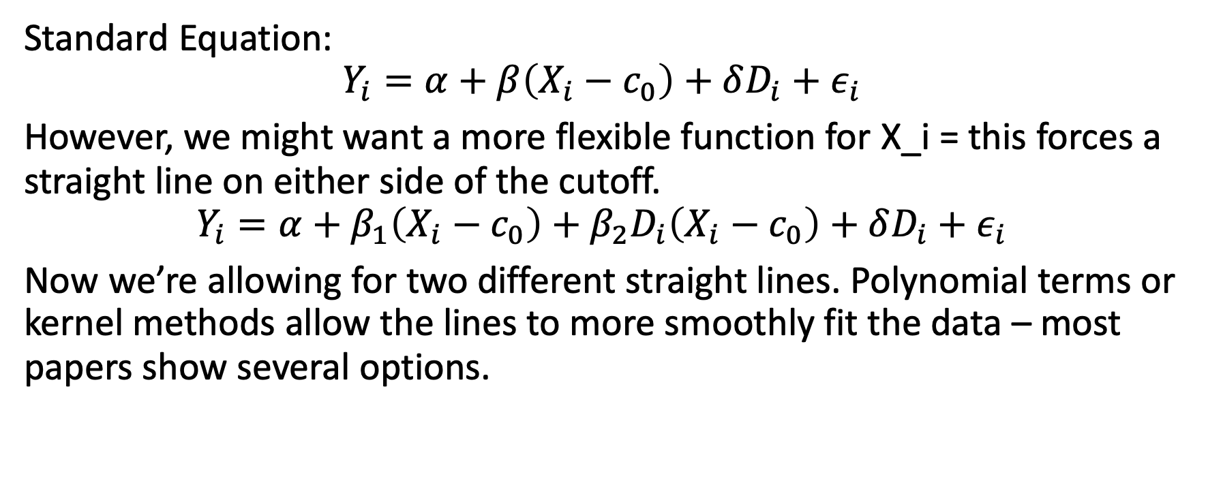
Estimation: Sharp RD
Standard Equation:
$$Y_{i}=α+β\left(X_{i}−c_{0}\right)+δD_{i}+ε_{i}$$
However, we might want a more flexible function for X_i = this forces a straight line on either side of the cutoff.
$$Y_{i}=α+β_{1}\left(X_{i}−c_{0}\right)+β_{2}D_{i}\left(X_{i}−c_{0}\right)+δD_{i}+ε_{i}$$
Now we’re allowing for two different straight lines. Polynomial terms or kernel methods allow the lines to more smoothly fit the data – most papers show several options.

Slide 14
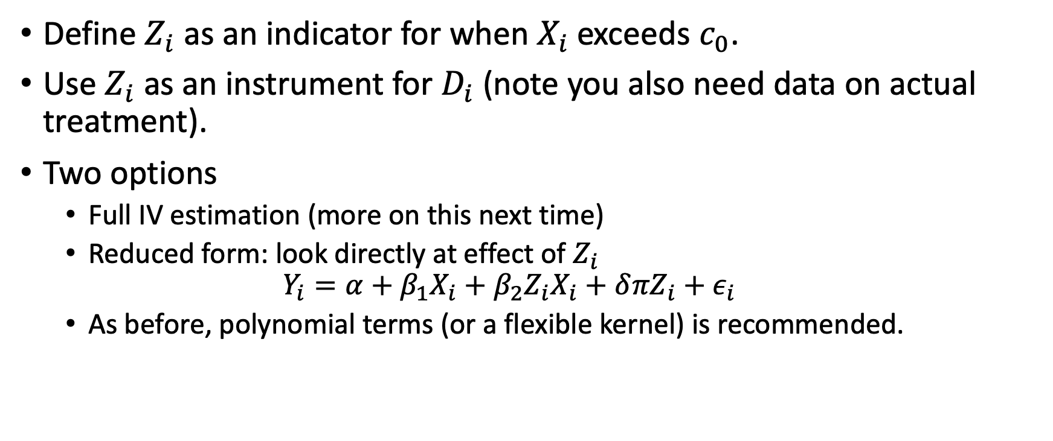
Estimation: Fuzzy RD
Define $Z_{i}$ as an indicator for when $X_{i}$exceeds $c_{0}$.
Use $Z_{i}$ as an instrument for $D_{i}$ (note you also need data on actual treatment).
Two options
Full IV estimation (more on this next time)
Reduced form: look directly at effect of $Z_{i}$
$$Y_{i}=α+β_{1}X_{i}+β_{2}Z_{i}X_{i}+δ{πZ}_{i}+ε_{i}$$
As before, polynomial terms (or a flexible kernel) is recommended.

Slide 15
Identification Challenges
Problems with the continuity assumption can arise if:
Assignment rules are known in advance
Agents want to adjust (e.g. retake a test)
Agents have time to adjust
The cutoff is endogenous to factors that independently cause potential outcomes to shift.
There is nonrandom heaping along the running variable

Slide 16
McCrary Test

Slide 17
Covariate Balance

Slide 18
Methods Time

Slide 19
Canvas Survey
Answer questions 1-3 on the canvas ”Methods” survey
We’ll discuss where everyone is at as a group.
Goal today: complete a very simple version of your data analysis.

